Slide 1
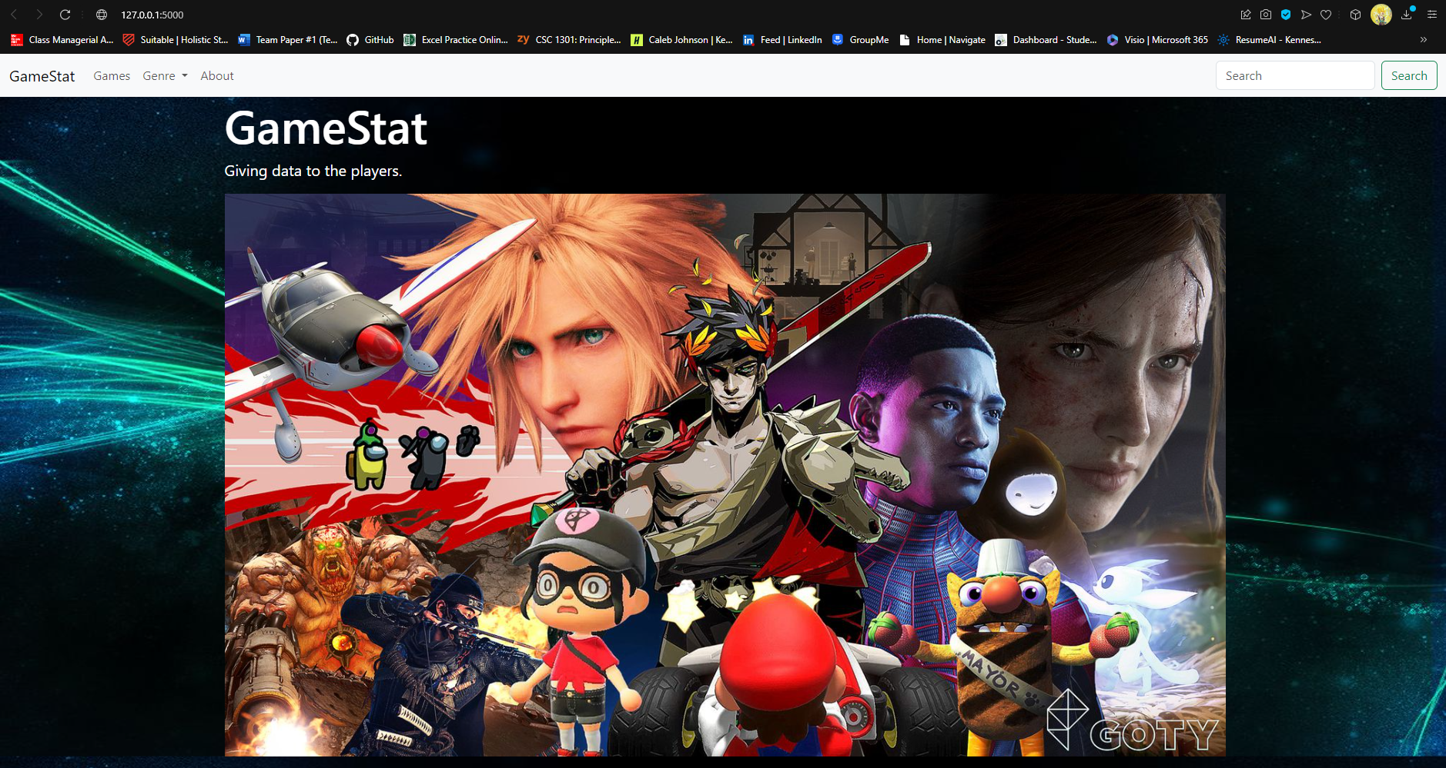

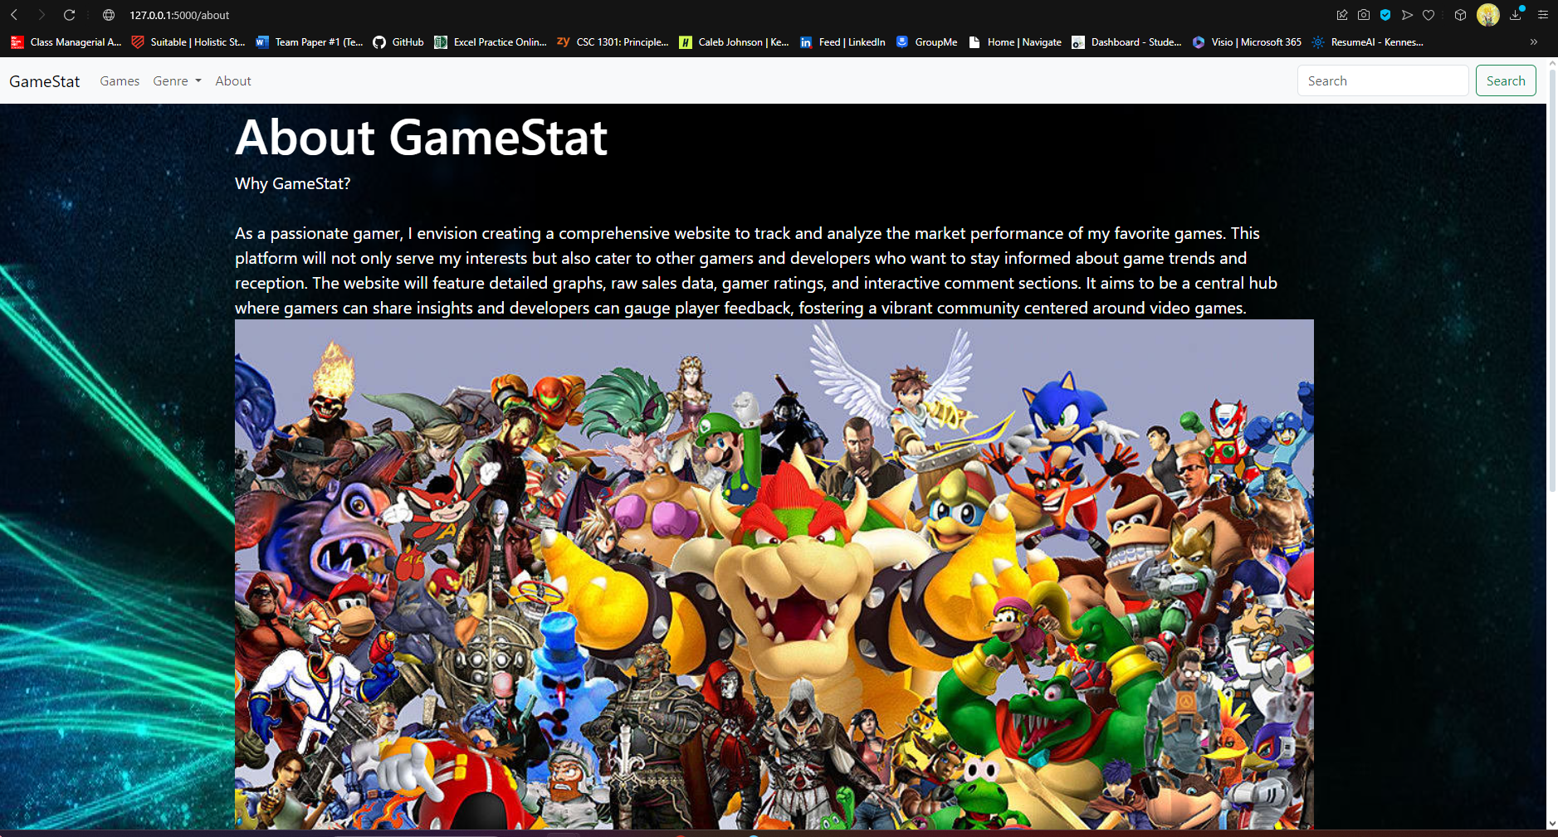
GameStat Giving Data to the Players
By Caleb Johnson

